Slide 1
Fuel Monitoring
MCA MAIN PROJECT
Greena J Helan
MCA-A
Roll No:55

Slide 2
01
Project Title
02
Relevance of Topic
03
A Description of the project
04
Objectives Of Studies
Contents
05
Existing System and Proposed System
CONTENTS
06
06
Input/ Output and Modules.
07
Algorithm to be used
08
Data Set
Data Set

Slide 3

Project Title:
FUEL MONITORING

Slide 4
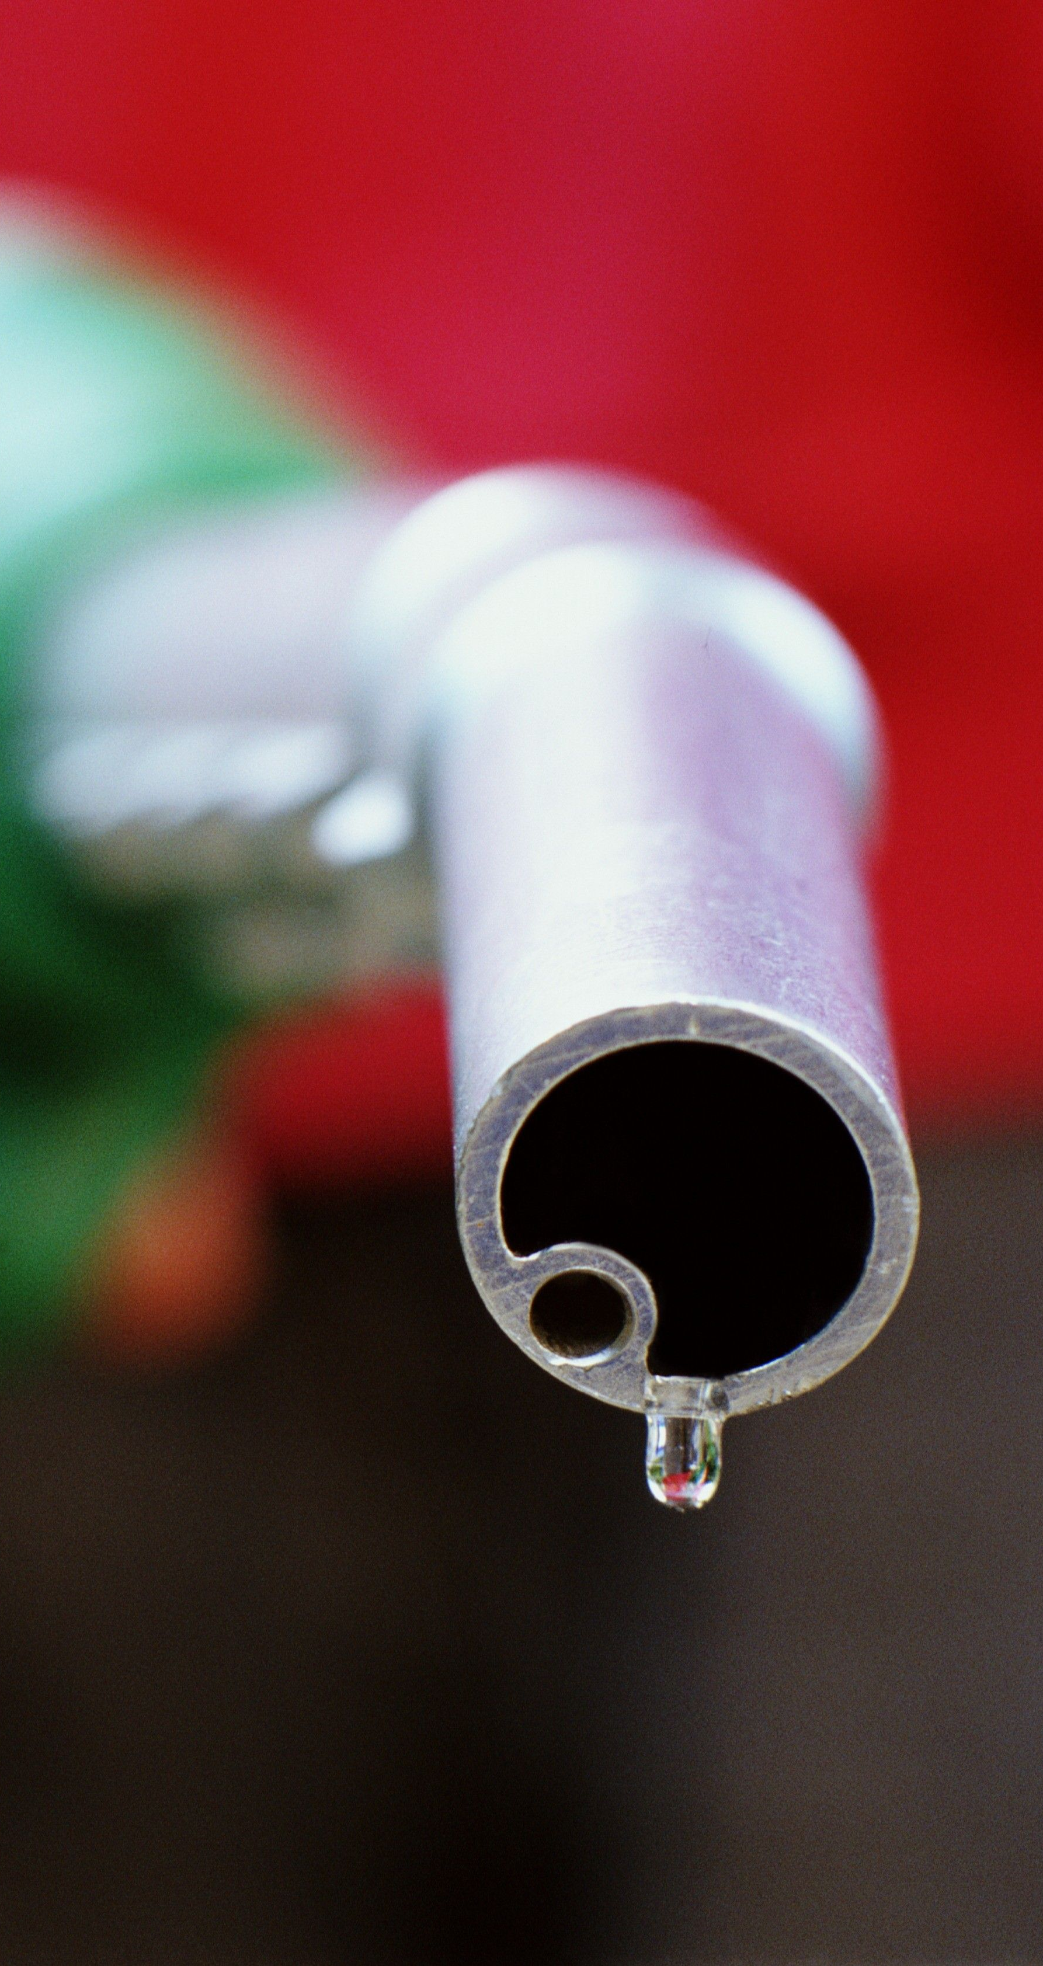

Relevance Of Topic
Fuel consumption will help to calculate mileage of the vehicle based on the vehicle used.
Check the amount of co2 in a vehicle to avoid accidents and pollution.
By predicting the Fuel price early we can buy the stock products by this Pump owners will get profit.

Slide 5

Project Description
The Main Aim of the project is to predict fuel price prediction using ML and predict the amount of fuel consumed by a vehicle in a particular distance in city , Highways and the amount of CO₂ generated in vehicle .
The Prediction depends on several internal factors such as model year, fuel type, cylinders, carmaker, class type and transmission type.
Machine learning techniques are widely applied to this. Random Forest, Multiple Linear Regression models is using to get accurate prediction.

Slide 6
Objective Of The Project
The aim of Fuel Monitoring is to predict price of Fuel which help to know the upcoming days fuel price to an extend.
The know amount fuel consumed to move our vehicle in a particular distance and the amount CO₂ generated from our vehicle. Which helps to reduce the pollution.

Slide 7
Existing system
Fuel price is known in News paper
Milage of a vehicle testing using manually by particular amount of fuel taken and drive the vehicle up to finish it.
CO₂ is testing in smoke testing centre.
Fuel Price is predicted Using Linear Regression with low accuracy
Proposed system
predict the Fuel Consumption of vehicle in city and Highway Separately
predict the amount of CO₂ generated in our vehicle using Machine Learning Algorithm.
Fuel price and Fuel consumption can predict in one application
Predict Fuel Price advanced using Random Forest Algorithm
Machine learning techniques are widely applied to this. Random Forest. Multiple linear Regression models is using to get accurate prediction.

Slide 8
Modules &input/output

Slide 9
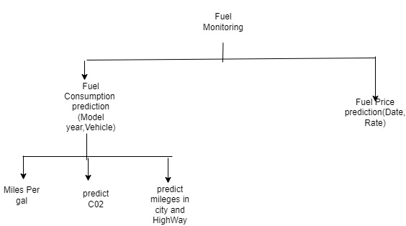
Modules
1.Fuel _City
2. Fuel _Highway
3. Fuel_Comb
4. CO2_Emission
5. Petrol_Price
6.Diseal_Price

Slide 10
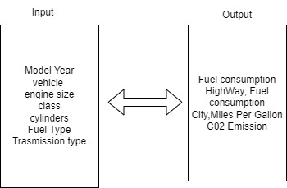
Input/Output

Slide 11

Algorithm Used:
Multiple Linear Regression
Multiple linear regression (MLR), also known simply as multiple regression, is a statistical technique that uses several explanatory variables to predict the outcome of a response variable. The goal of multiple linear regression is to model the linear relationship between the explanatory (independent) variables and response (dependent) variables. In essence, multiple regression is the extension of ordinary least-squares (OLS) regression because it involves more than one explanatory variable.
Random Forest Algorithms
Random forest is a Supervised Machine Learning Algorithm that is used widely in Classification and Regression problems. It builds decision trees on different samples and takes their majority vote for classification and average in case of regression.

Slide 12
Dataset

Slide 13
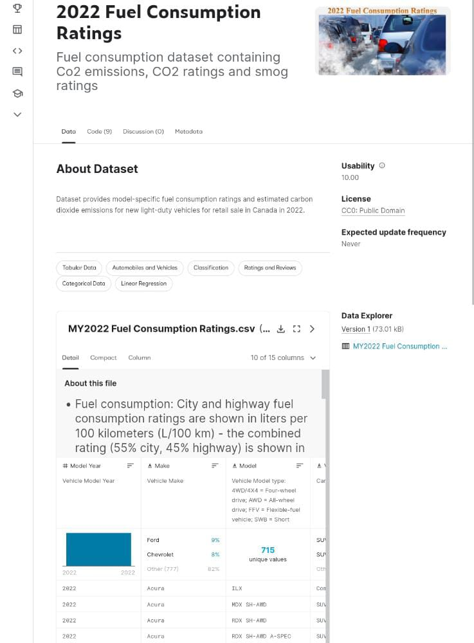
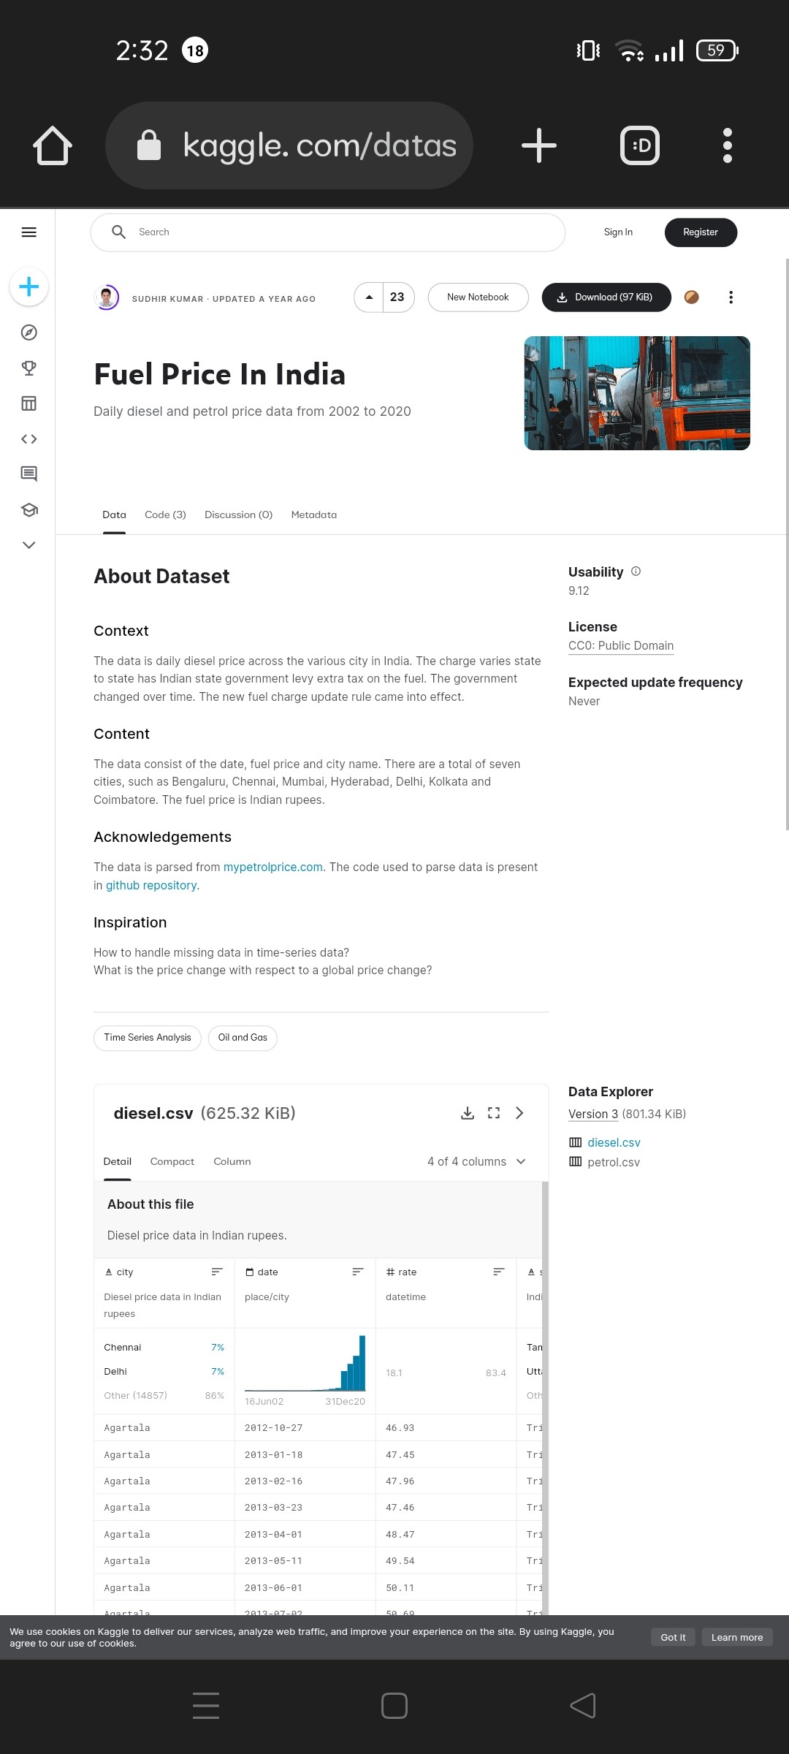
Fuel consuming Ratings
Dataset provides model-specific fuel consumption ratings and estimated carbon dioxide emissions for new light-duty vehicles for retail sale in Canada in 2022.
Fuel price Prediction
Dataset provides model-specific fuel price ratings

Slide 14
ScreenShot

Slide 15
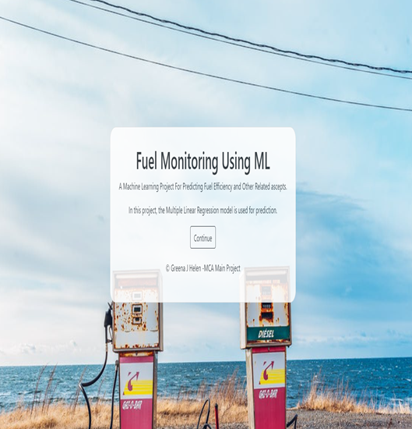
1.Home Page 3.Page

Slide 16
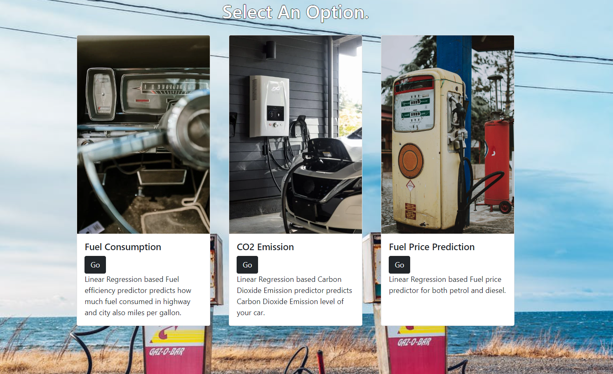
2.Option Page

Slide 17
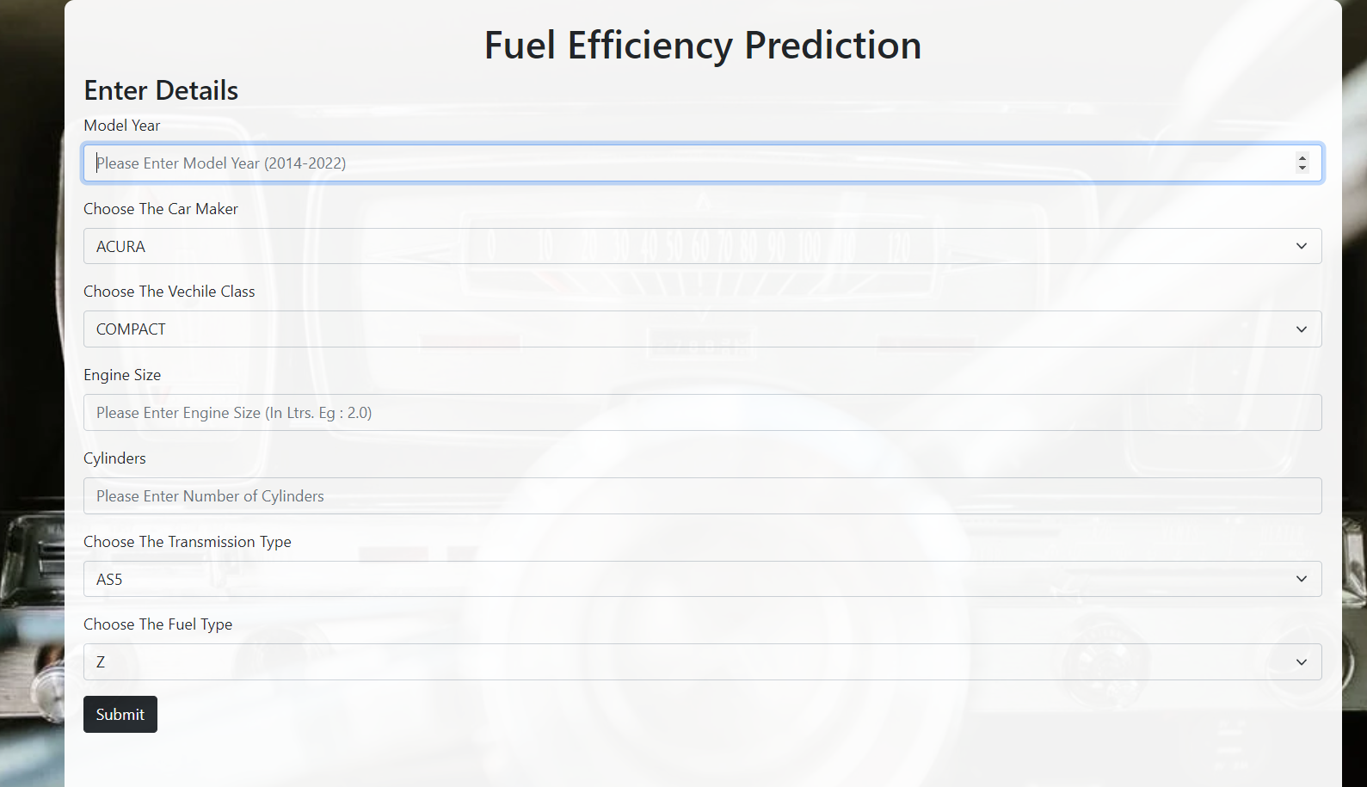
3.Fuel Cosumption Page

Slide 18
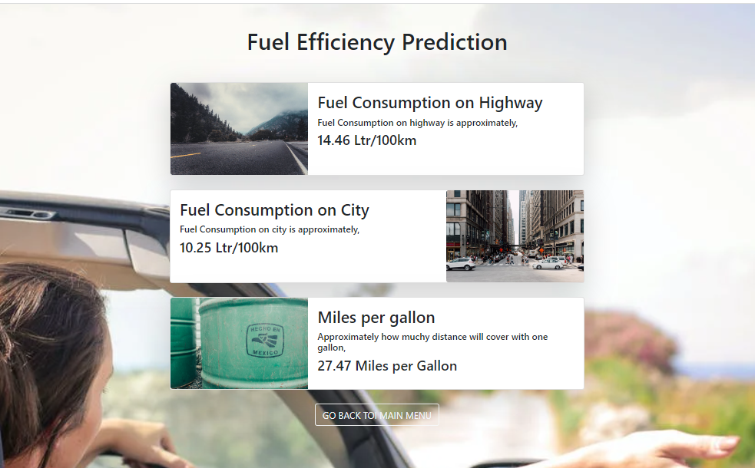
4.Efficency Prediction Page

Slide 19
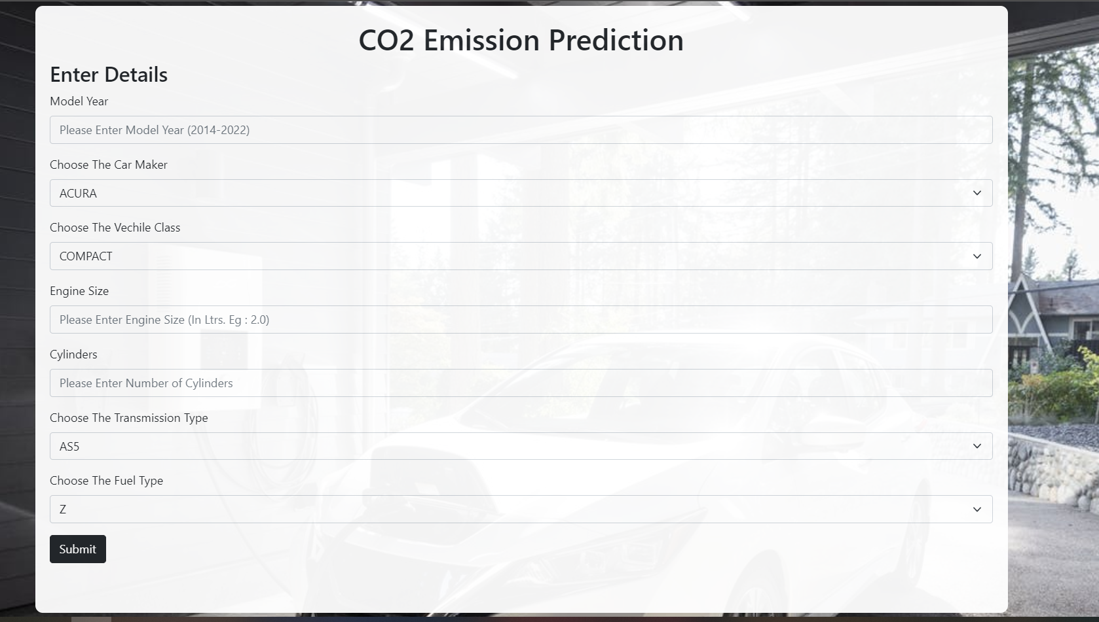
5.C02 Emission Page

Slide 20
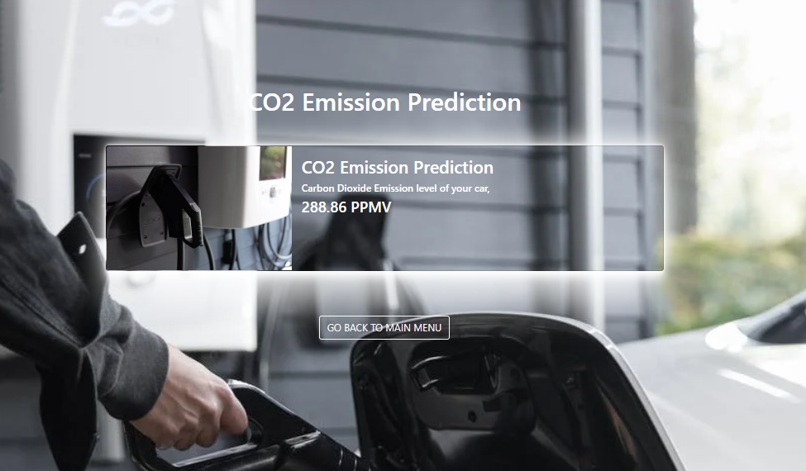
6.C02 Prediction Page

Slide 21
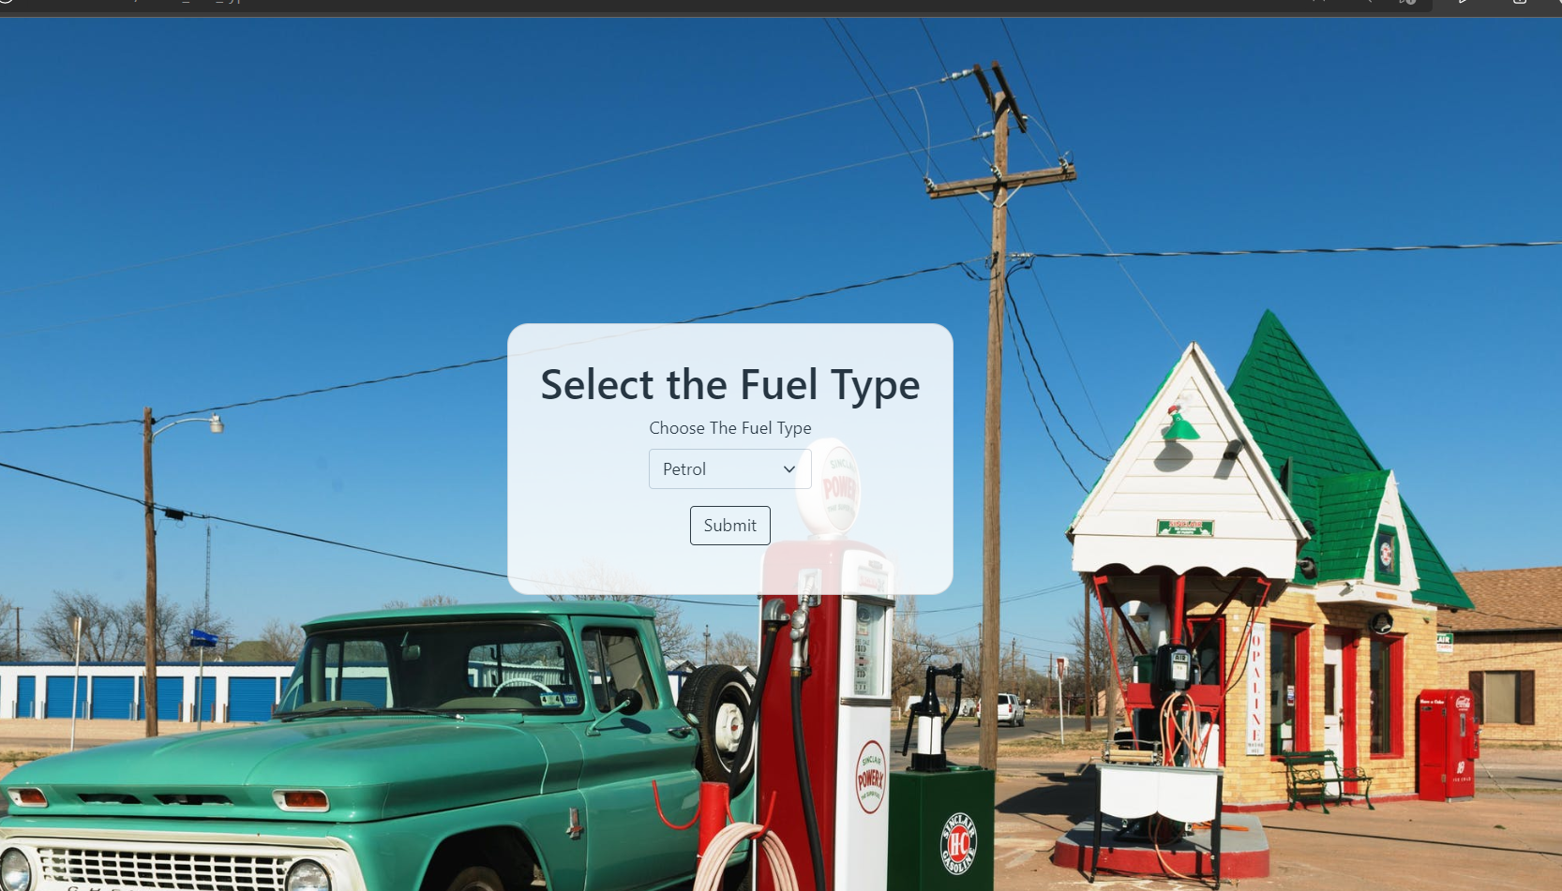
7.Fuel Home Page

Slide 22
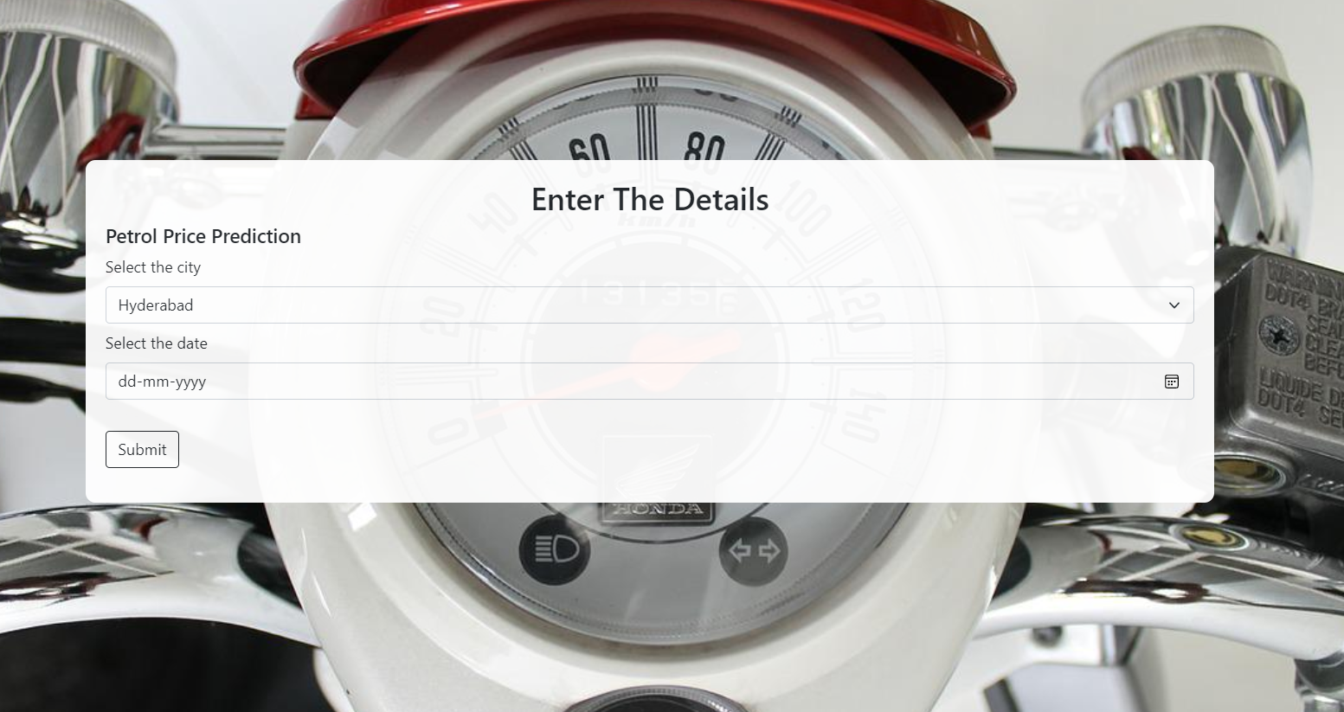
8.Petrol Page

Slide 23
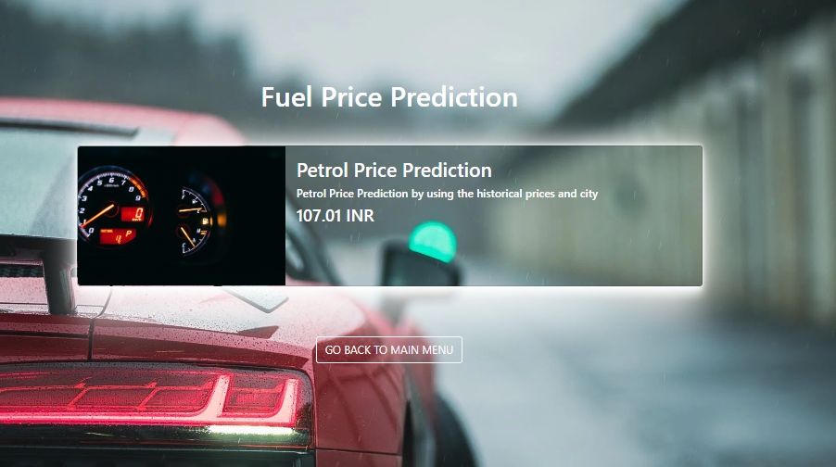
9.Petrol Prediction Page

Slide 24
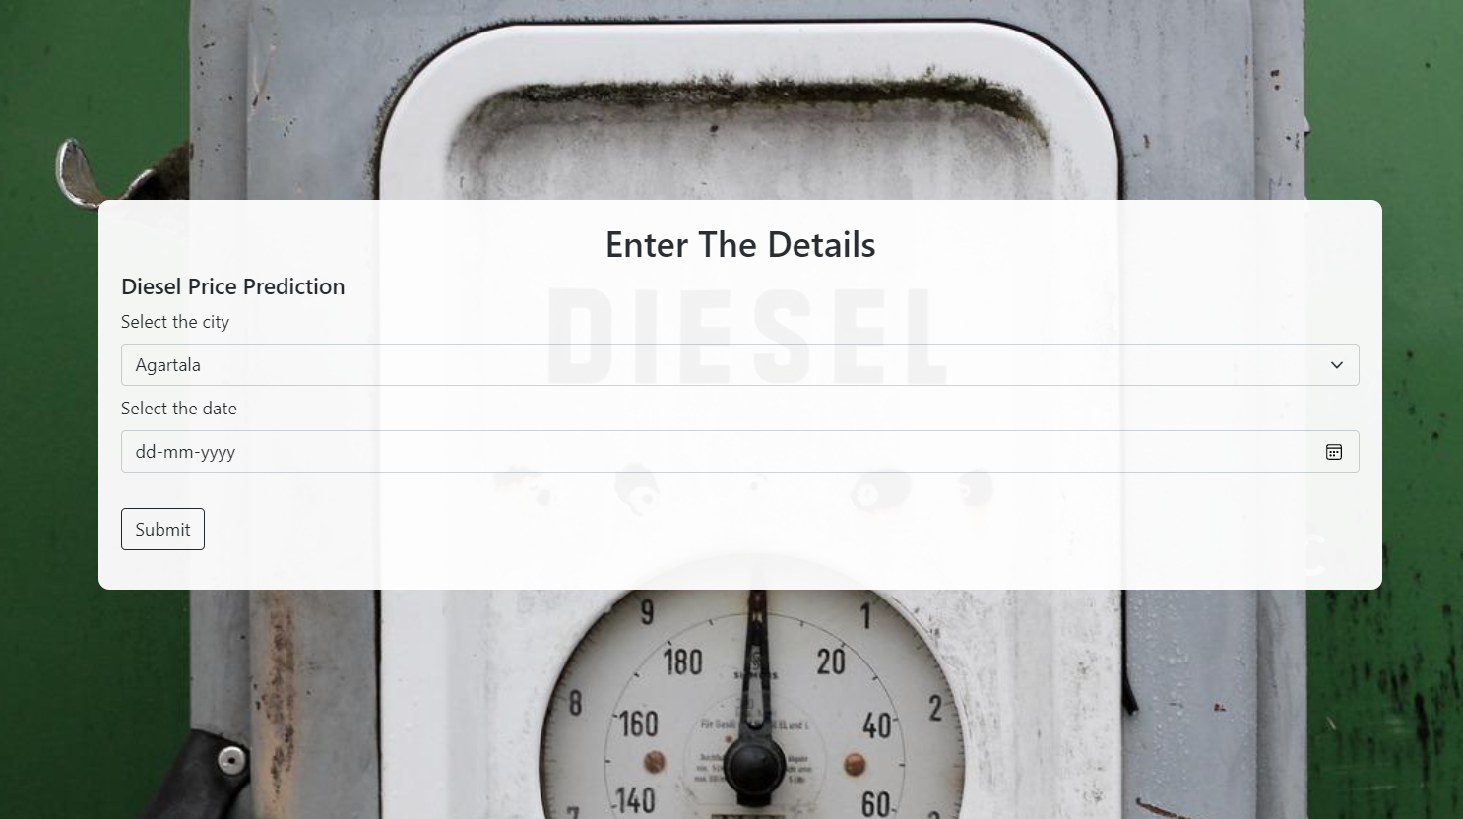
10.diesel Page

Slide 25
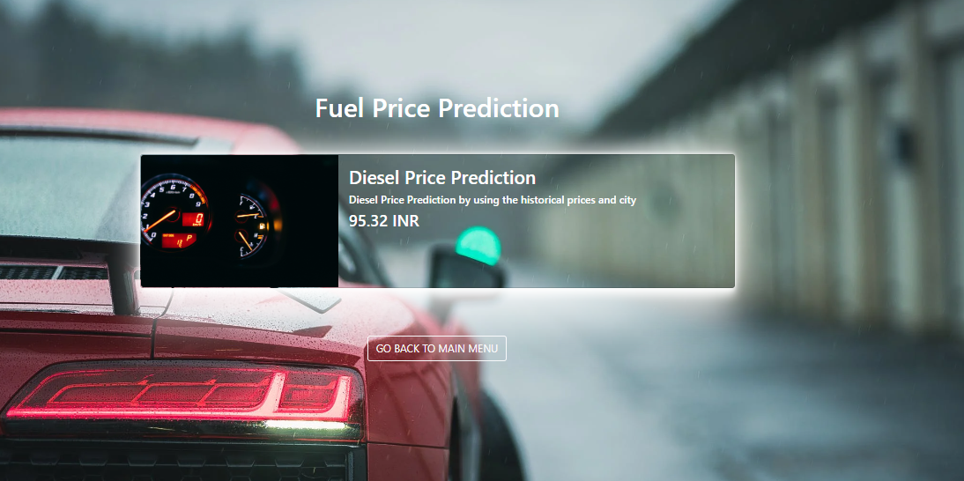
11.Diesel Prediction Page

Slide 26
THANK YOU….

